Slide 1

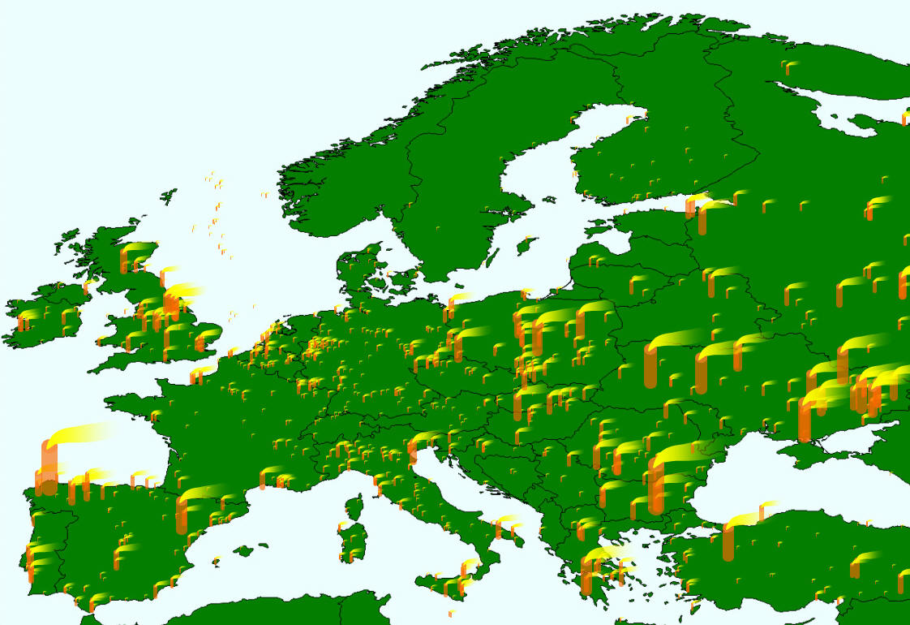
International energy scenarios a systems approach to modelling energy scenarios at an international level
UCL Energy Institute MRres
Mark Barrett
Mark.Barrett@ucl.ac.uk

Slide 2
Contents
What’s it all for?
What systems are there?
What is a model?
Modelling process?
Scenarios for the EU
The problem of space and time

Slide 3
Homo sapiens
Energy and material demands
  tissue formation and maintenance
  keeping warm, keeping cool
  movement
  information processing
Energy from oxidising carbon in food, renewable biomass
Refined control systems to minimise energy and water consumption
Comfort is when energy and water consumption is minimised
Most exosomatic services (buildings, transport) designed to minimise endosomatic energy consumption, to achieve comfort – this is a basic driver of energy demand
e.g. 10% UK energy & emissions to keep warm air next to skin

Slide 4
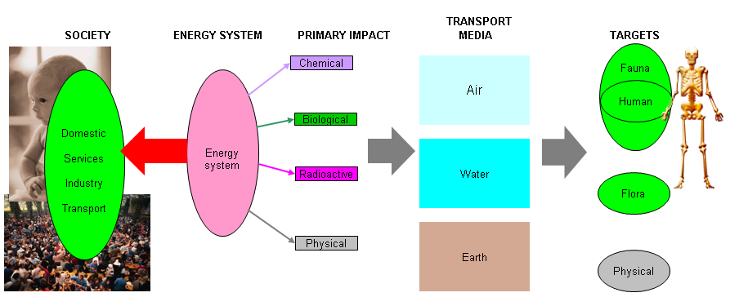
The society, energy environment system
People in society have energy service demands that are met by energy systems which cause primary inputs to the environment. These inputs are modified and transported via media to impact on biota.

Slide 5
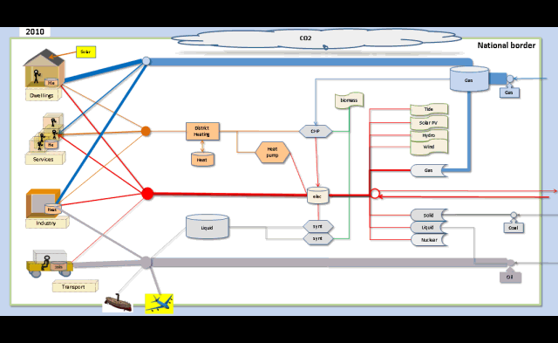
The whole system animated

Slide 6
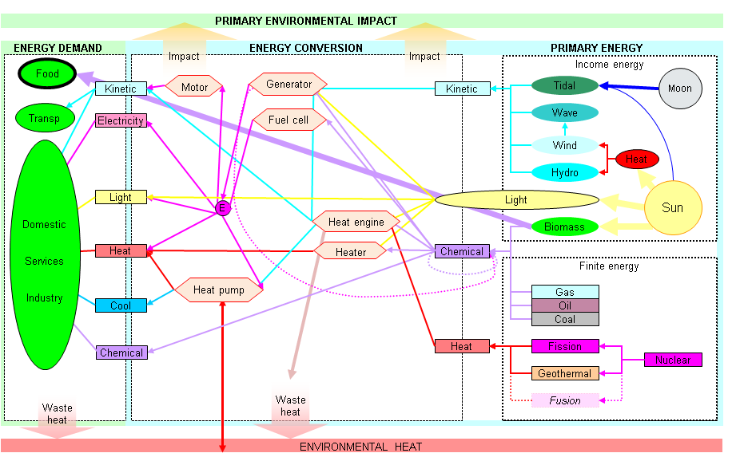
The energy system: demand and supply options
Energy demands and sources can be linked in many ways. The appropriate linkage depends on a complex of their distribution in space and time, and the economics of the technologies used.

Slide 7
Energy, space and time problem
What is the best configuration?
What capacities?
Where to locate converters and stores?
Where to place transmission nodes?

Slide 8

DYNAMICS – WHAT AND WHY
Long term dynamics – changes to capital stocks (buildings, power stations, etc.) in scenarios transforming whole energy system
Short term dynamics - demand-supply matching over minutes to months
1 and 2 required for optimisation of system design.
2 required:
to ensure system is technically feasible e.g. mix of renewables and dispatchable generators works;
to explore potential of fast measures such as load management and spatiotemporal controls in buildings
to do accurate costing and estimation of emissions, environment and health impacts, etc.

Slide 9
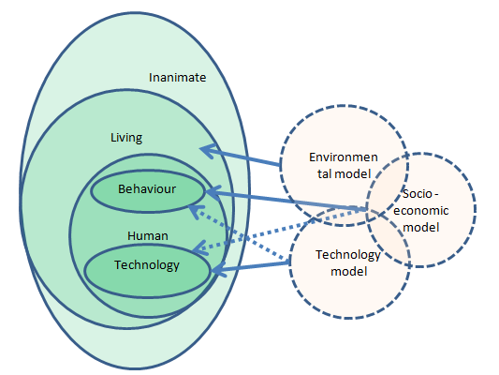
The society, energy environment system and models

Slide 10
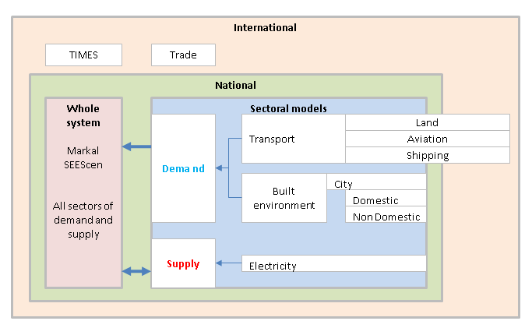
Models and data - UCL Energy Institute
Energy systems are fractal, so a range of models and data are required

Slide 11
What is a model?
Representation of a bounded physical system (social and/or technological)
  Internal relationships based on historical data
  Exogenous data inputs:
    Initial system state based on historical data
    Future values from system environment
Domains of model
  Physical variables only
  Socioeconomic
Types and methods of modelling
  Dynamic and static
  Simulation: with differential equations
  Statistical: Monte Carlo
  Optimisation: linear /non linear programming, genetic algorithms, etc.

Slide 12
The modelling process
What is the question? What is the curiosity?
Collation of information about the world
  Processes – how do things work?
  Historical state of the system being modelled and exogenous factors
Build a model
  Structure data
  What software and hardware environment will be used?
  Write programme to
    input data
    emulate processes, simulate, optimise
    Output data
Validate the model
  Does the model reflect reality as described by historical data?
Practicalities
  Money?
  Who will build model?
  Who will run it?

Slide 13
The challenge
Develop EU integrated policy that achieves environmental and energy goals at least overall cost.

Slide 14
Objectives, instruments and measures

Slide 15
OBJECTIVES OF STRATEGY
SOCIAL, ECONOMIC, POLITICAL
Meet objectives at least cost with social equity
Avoid irreversible, risky technologies
ENERGY SECURITY
Reduce dependence on finite fossil and nuclear fuels
UK 20% of energy from renewables by 2020 => ~35% renewable electricity?
renewable transport fuels: 5% of by 2010, 10% by 2020
ENVIRONMENT
UK
Government targets for GHG reduction from 1990: 12-20% by 2010, ~30% by 2020, 60-80% 1990-2050, including international transport.
Require >95% GHG reduction for climate control and global equity
Europe
20/30% GHG reduction 1990-2020

Slide 16
Ethics: equal CO2 emission per person?
Humans have equal rights to emissions, therefore convergence of emission per person in the EU and elsewhere? What about different resources and climate of countries? Note that for global equity, EU per capita emissions will have to fall by over 95% to reach 60% reduction globally.

Slide 17
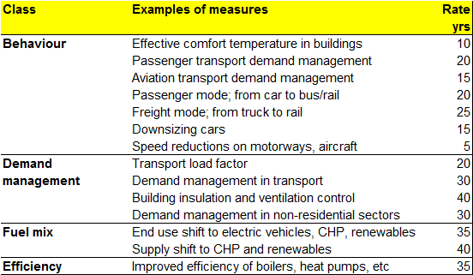
Policy measures: physical measures and rate of change
Size of effect, rate of effect and cost

Slide 18
Technical basis: SEEScen: Society, Energy, Environment Scenario model
SEEScen is applicable to any large country having IEA energy statistics
SEEScen calculates energy flows in the demand and supply sectors, and the microeconomic costs of demand management and energy conversion technologies and fuels
SEEScen is a national energy model that does not address detailed issues in any demand or supply sector.
Method
Simulates system over years, or hours given assumptions about the four classes of policy option
Optimisation under development

Slide 19
UK Energy flow chart: 1990

Slide 20
Scenario context: UK Energy flow chart: animation 1990 to 2050

Slide 21
Scenario context: UK Energy flow chart: 2050

Slide 22
Scenarios
Six scenarios for each EU25 country were constructed to reach these objectives using different combinations of NEOP measures implemented to different degrees.

Slide 23
Energy services and demand drivers
Demands for energy services are determined by human needs, these include
food
comfort, hygiene, health
culture
Important drivers of demand include:
Population increases
Households increase faster because of smaller households
Wealth, but energy consumption and impacts depend on choices of expenditure on goods and services which are somewhat arbitrary
The drivers are assumed to be the same in all scenarios.
The above drivers are simply accounted for in the model, but others are not, for example:
Population ageing, which will result in increases and decreases of different demands
Changes in employment
Environmental awareness
Economic restructuring
More on consumption at:
http://www.sencouk.co.uk/Consumption/Consumption.htm

Slide 24
Exogenous assumptions (from PRIMES WCLP scenario): basic drivers
Population peaks and declines
More households
GDP growth

Slide 25
Exogenous assumptions (from PRIMES): transport demand
More passenger travel
But is saturation occurring, e.g. UK?
More travl per capita

Slide 26
Exogenous assumptions (from PRIMES): transport demand
Why?
What if travel costs go up?
More freight transport

Slide 27
Exogenous assumptions: nuclear power
Profile with 35 years life
PRIMES profile with replacement.
Is this feasible?

Slide 28
SEEScen sample: Domestic sector: house heat loss factors
Implementation of space heat demand management (insulation, ventilation control) depends on housing needs and stock types, replacement rates, and applicability of technologies. Insulation of the building envelope and ventilation control can reduce house heat losses to minimal levels.

Slide 29
Transport: measures
Demand management, especially in aviation sector
Reduction in car power and top speed
Increase in vehicle efficiency
  light, low drag body
  improved motor efficiency
Speed reduction for all transport
Shift to modes that use less energy per passenger or freight carried:
  passengers from car to bus and train
  freight from truck to train and ship
Increased load factor, especially in the aviation sector
Some penetration of vehicles using alternative fuels:
  electricity for car and vans
  biofuels principally for longer haul trucks and aircraft

Slide 30
SEEScen sample: Transport: passenger demand by mode and vehicle type
Demand depends on complex of factors: demographics, wealth, land use patterns, employment, leisure travel. National surface demand is limited by time and space, but aviation is not so limited by these factors.

Slide 31
SEEScen sample: Transport: passenger vehicle distance
Demand management and modal shift can produce a large reduction in road traffic reduces congestion which gives benefits of less energy, pollution and travel time.
Assumed introduction of electric vehicles to replace liquid fuels, and reduce urban air pollution.

Slide 32
Cars: carbon emission by performance
Car carbon emissions are strongly related to top speed, acceleration and weight. Most cars sold can exceed the maximum legal speed limit by a large margin. Switching to small cars would reduce car carbon emissions by some 50% in 15 years in the UK (about 7% of total UK emission). Switching to micro cars and the best liquid fuelled cars would reduce emissions by 80% and more in the longer term. In general, for a given technology, the emissions of pollutants are roughly related to fuel use, so the emission of these would decrease by a similar fraction to CO2.

Slide 33
Transport: road speed and CO2 emission
Energy use and carbon emissions increase strongly at higher speeds. Curves for other pollutants generally similar, because emission is strongly related to fuel consumption.
These curves are only applicable to current vehicles. The characteristics of future vehicles (e.g. urban internal combustion and electric powered) would be different. Minimum emission would probably be at a lower speed, and the fuel consumption and emissions at low speeds would not show the same increase.
Potentially, the lowering of actual speeds on fast roads might reduce emissions on those roads by perhaps 10-20%.
Low speed emission
Average conceals start/ stop congestion
And car design dependent

Slide 34
SEEScen sample: Transport: passenger: delivered energy
International air travel will become a large fraction of future passenger energy use

Slide 35
SEEScen sample: UK : electricity generation (not consumption)
Switch from electricity only fossil generation to:
Fossil CHP for medium term, and biomass CHP
Renewable sources

Slide 36
SEEScen sample: UK : CO2 excluding international transport

Slide 37
SEEScen sample: UK CO2 by scenario

Slide 38
SEEScen sample: EU25 CO2 emissions by country : EU30pc20N scenario
. The black squares show the targets for 2010 and a 30% reduction by 2020.

Slide 39
SEEScen sample: EU25 CO2 : variant scenarios
40% reduction
New nuclear
Maximum behaviour
No new nuclear
Maximum technology
No new nuclear
Maximum technology and behaviour
No new nuclear

Slide 40
SEEScen sample: Energy security
EU25 energy trade : including fuels for international transport: EU30pc20N scenario

Slide 41
SEEScen sample: Total cost by scenario: illustrative
It is possible that some low carbon scenarios will cost less than high carbon scenarios.
It is certain that reducing imports will enhance economic stability because of a lower trade imbalance, and less dependence on fluctuating fossil fuel prices.

Slide 42
Further issues: aviation
  International aviation and shipping should be included in GHG inventories because their GHG emissions will become very large fractions of total.
  Low level. Airports are emission hot spots because of aircraft taxiing, and landing and take-off, and because of road traffic.
  Tropospheric emission. Aircraft emit a substantial quantities of NOx whilst climbing to tropopause cruising altitude (about 12 km). This will contribute to surface pollution.
  Tropopause/low stratosphere emission. The high altitude emission of NOx and water vapour cause 2-3 times the global warming due to aviation CO2. Aviation may well become the dominant energy related greenhouse gas emitter for the UK over the coming decades.
  Of all the fossil fuels, kerosene is the most difficult to replace.
  Further information on this is given in the references.

Slide 43
Conclusions: 1
Demand
Large energy demand reduction feasible with technologies in all sectors, but smaller reductions in road freight transport, aviation and shipping.
Behavioural change very important, especially in car choice and use, and air travel.
Supply
A shift from fossil fuel heating to solar and electric heat pumps
A shift from fossil electricity generation to a mix of renewables
Large renewable electricity potential and Europe might become a net exporter of electricity
but remain a large importer of oil
Renewable energy fraction difficult to define.
Main problem is replacing fossil liquid transport fuels, especially for aircraft and ships

Slide 44
Conclusions: 2
Large CO₂ reductions possible
Date and rate of introduction of measures critical.
Low carbon scenarios have a lower total and air pollution control cost than high carbon scenarios
Demand reduction and renewables address all problems simultaneously

Slide 45
Detailed spatio-temporal modelling
  Energy scenarios have annual energy flows.
  Will the energy systems work:
  Temporally: hour by hour, day by day and month by month?
  Spatially: what are the requirements for distributing energy spatially?

Slide 46

Building dynamics
Wait for animation to run
Weather and
Occupancy, over hours and months, drive:
ventilation
energy flows
pollution
personal exposure

Slide 47
Heat development – strategic issues
Long development time so need to consider several decades.
Given socioeconomic development and efficiency improvements, what is the ‘end state’ for:
Heat demands in terms of:
quantity
temperature
space
time
Heat loads:
Buildings – HW, space
Industry – process heat
Fuel synthesis – HT heat
Heat supply:
Electric heat pumps
Biomass – availability and spatial distribution
  fuel synthesis (ammonia, hydrocarbons, hydrogen and processing
Solar, geothermal
Waste heat
  industry

Slide 48
Dwellings; two archetypes
Heat pump single source peaks little storage
District heat diversity multiple inputs cheap storage implementation
Notes:
DynEMo models a range of dwellings and occupancy types. Two commonly proposed archetypes are shown in here.

Slide 49
Building dynamics : heating
Winter’s day
Months 1,4,7

Slide 50
Building dynamics : solar heater
Winter’s day
Months 1,4,7

Slide 51
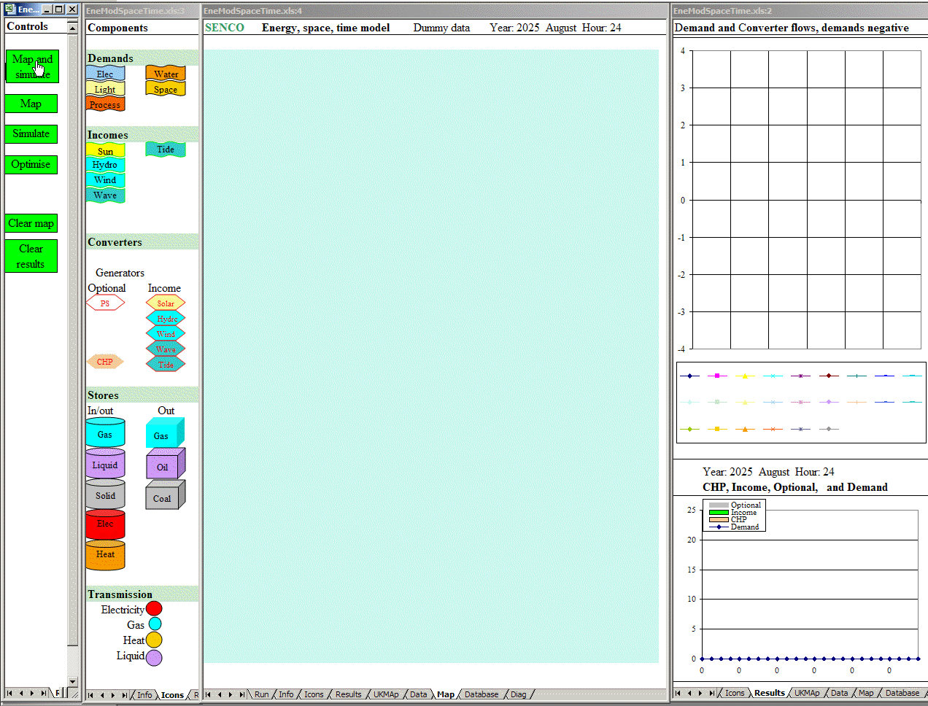
UK energy, space and time : animated

Slide 52
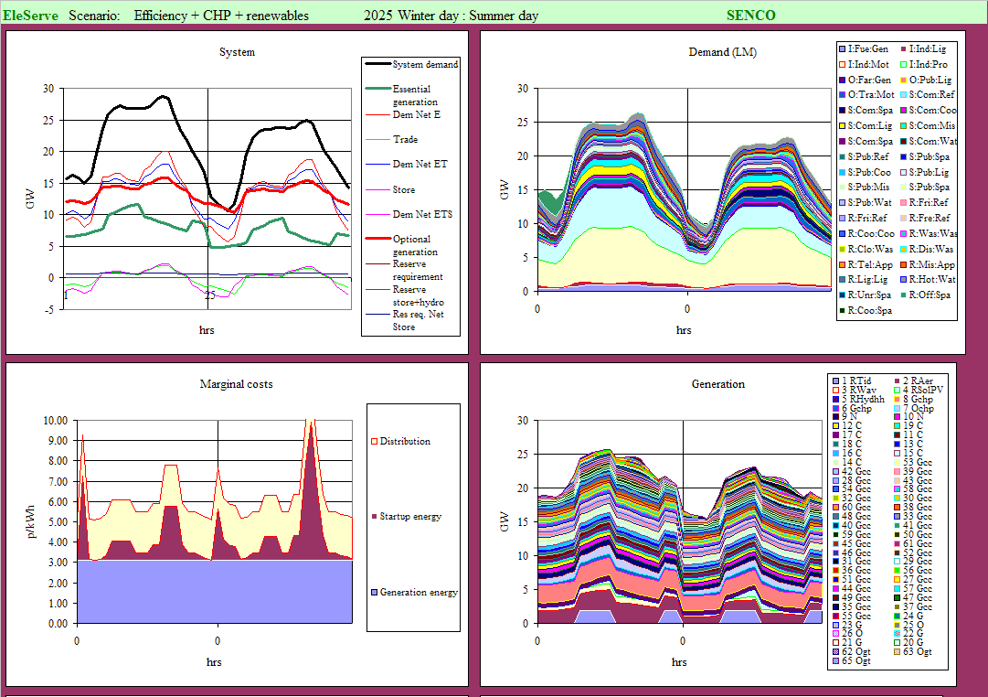
Electricity : diurnal operation without load management

Slide 53

Electricity : animated load management optimisation

Slide 54
Electricity : diurnal operation after load management

Slide 55
VarInt : Sample day : winter’s day of variable supply excess

Slide 56
VarInt : Sample day : winter’s day of variable supply deficit

Slide 57
VarInt : Optimised system : sample year
These charts show the sampled year performance of the optimised system for one set of weather.

Slide 58

VarInt : Day sampling : animation

Slide 59
InterEnergy – trade optimisation animated
This shows InterEnergy seeking a least cost solution.
It illustrates how patterns of electricity flow might change.
An increase in renewable electricity will require a higher capacity grid with more sophisticated control

Slide 60
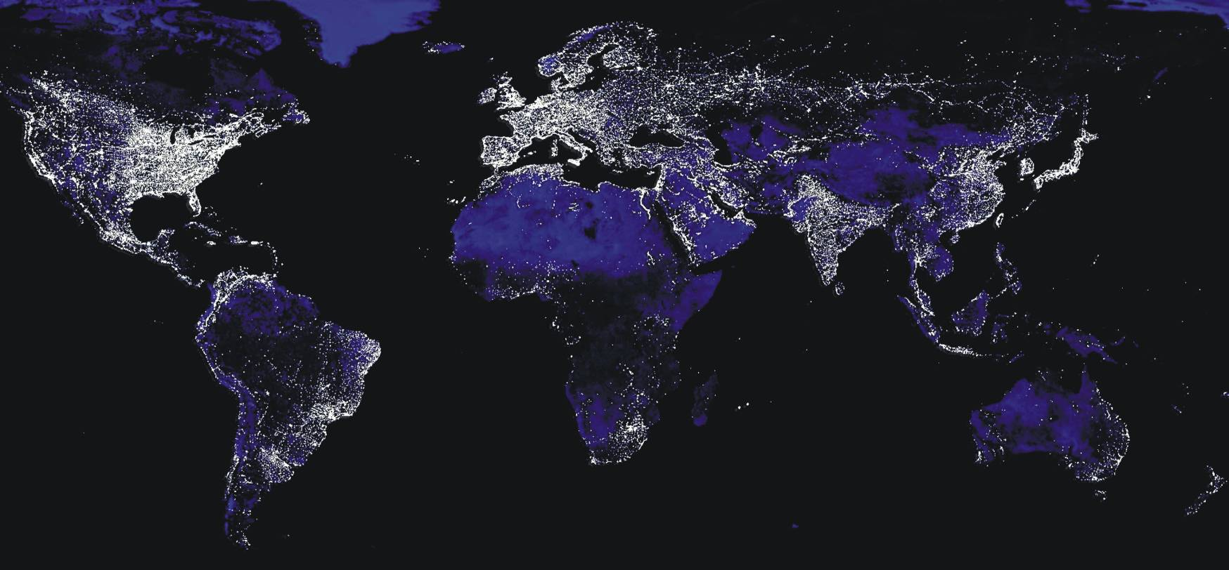
World
There are global patterns in demands and renewable supplies:
Regular diurnal and seasonal variations in demands, some climate dependent
Regular diurnal and seasonal incomes of solar energy
Predictable tidal energy income

Slide 61
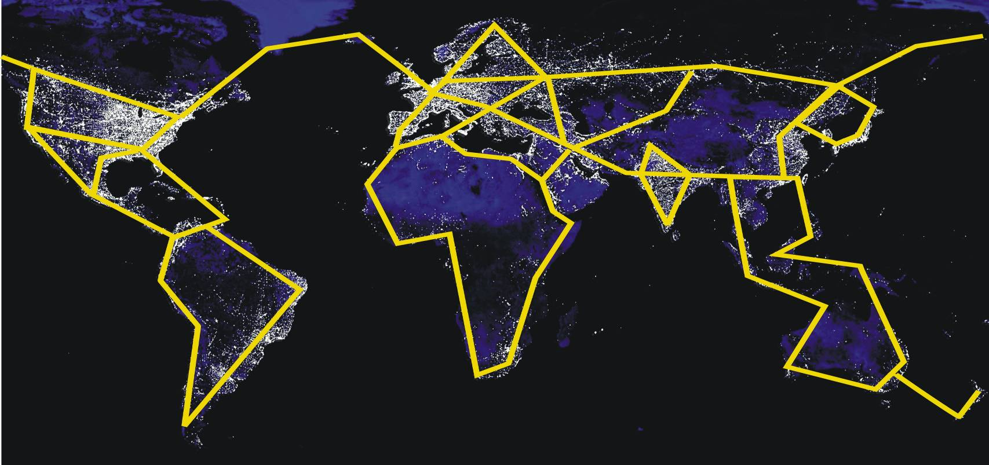
World: a global electricity transmission grid?
Should transmission be global to achieve an optimum balance between supply, transmission and storage?
Which investments are most cost efficient in reducing GHG emission? Should the UK invest in photovoltaic systems in Africa, rather than the UK? This could be done through the Clean Development Mechanism

Slide 62
Some whole system energy models
Institution Acronym Sectors Link
IEA TIMES/TIAM All http://www.etsap.org/applicationGlobal.asp
IEA MARKAL All http://www.etsap.org/markal/main.html
EPLEPFL GEMINI All http://gemini-e3.epfl.ch/
EEE WITCH All http://www.witchmodel.org/pag/model.html
EnerData POLES All http://www.enerdata.net/enerdatauk/solutions/energy-models/poles-model.php
IEA WEM All http://www.worldenergyoutlook.org/docs/weo2009/World_Energy_Model.pdf

Slide 63
References: Barrett
GENERAL:
http://www.bartlett.ucl.ac.uk/markbarrett/Index.html http://www.bartlett.ucl.ac.uk/markbarrett/Teaching/Educ.html
CONSUMPTION: Report on consumption, energy and carbon dioxide including behavioural measures.
http://www.bartlett.ucl.ac.uk/markbarrett/Consumption/EneCarbCons05.zip
TRANSPORT
Consultancy to DfT on project. Carbon Pathways: Analysis Informing Development of a Carbon Reduction Strategy for the Transport Sector, July 2008 .http://www.dft.gov.uk/pgr/sustainable/analysis.pdf
Overview of some aspects of sustainable transport : http://www.bartlett.ucl.ac.uk/markbarrett/Transport/TransportSus_MBarrett_020608.ppt
Summary presentation of some Auto-Oil work on transport and air quality, including some non-technical measures: http://www.bartlett.ucl.ac.uk/markbarrett/Transport/Land/AutoOil/JCAPWork.ppt
Aviation:
Technical scenarios http://www.bartlett.ucl.ac.uk/markbarrett/Transport/Air/Aviation94.zip
Effects of charges: http://www.bartlett.ucl.ac.uk/markbarrett/Transport/Air/AvCharge.zip
ELECTRICITY: Feasibility of a high renewable electricity system
Barrett, M. 2007, A Renewable Electricity System for the UK. In Renewable Energy and the Grid: The Challenge of Variability, Boyle, G., London: Earthscan. ISBN-13: 978-1-84407-418-1 (hardback).
http://www.cbes.ucl.ac.uk/projects/energyreview/Bartlett%20Response%20to%20Energy%20Review%20-%20electricity.pdf
http://www.bartlett.ucl.ac.uk/markbarrett/Energy/UKEnergy/UKElectricityGreenLight_100506.ppt
SCENARIOS
Barrett M, December 2007, Low Emission Energy Scenarios for the European Union, report 5785. ISBN 91-620-5785-5, ISSN 0282-7298. http://www.naturvardsverket.se/Documents/bokhandeln/620-5785-5.htm
Naturvårdsverket (Swedish environmental protection agency, SE-106 48 Stockholm www.naturvardsverket.se
Dynamic Physical Energy Model (1981)
www.bartlett.ucl.ac.uk/web/ben/ede/BENVGEED/ERG 044.pdf
www.bartlett.ucl.ac.uk/web/ben/ede/BENVGEED/ERG045_complete.pdf
HEALTH
Barrett M, Holland M, April 2008, The Costs and Health Benefits of Reducing Emissions from Power Stations in Europe. Published by the Air Pollution and Climate Secretariat and the European Environmental Bureau. ISBN: 978-91-975883-2-4
ISSN: 1400-4909. http://www.airclim.org/reports/APC20_final.pdf

